Slide 1
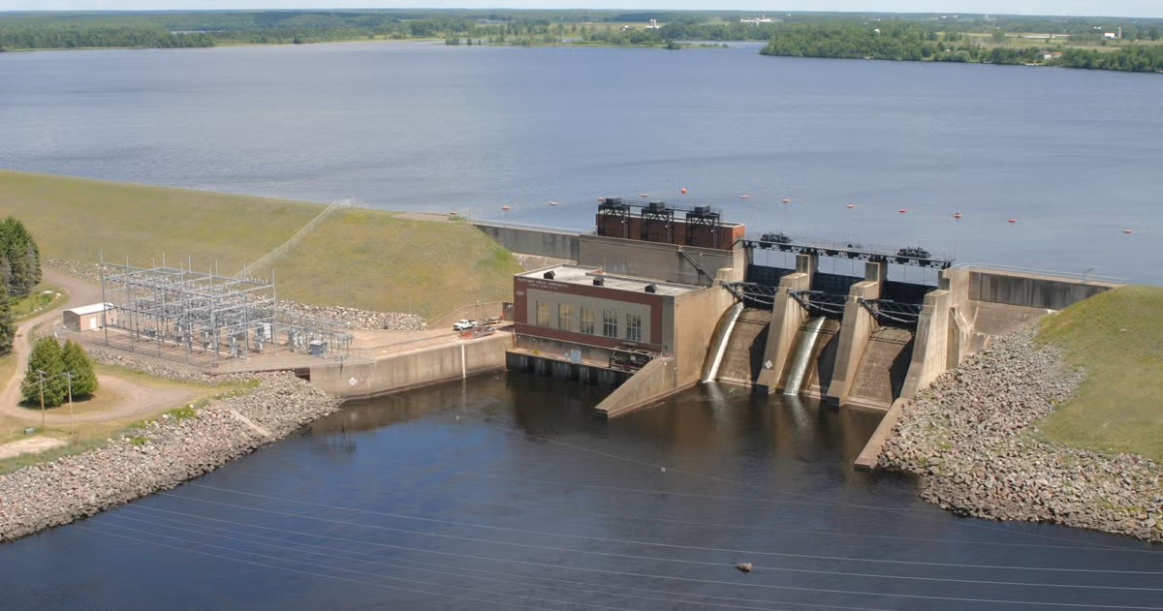
Predicting Hydroelectric Power Generation at Flambeau Station
Quantitative Analyst Internship Interview – Dairyland Power Cooperative
Andrew Peirce

Slide 2

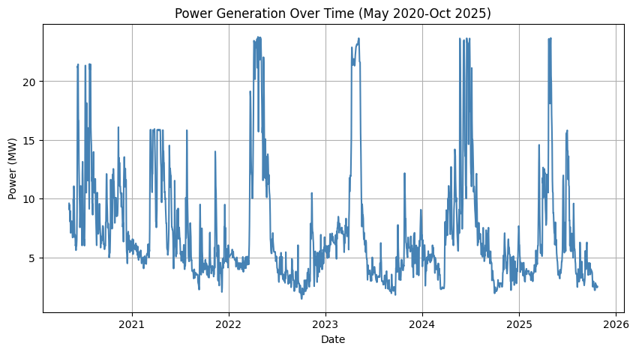
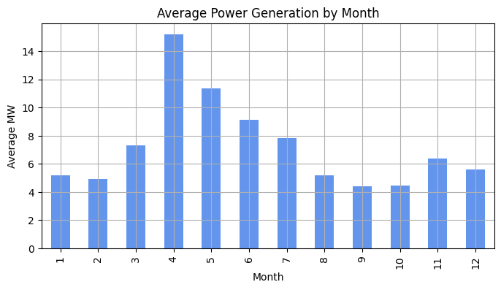
Exploratory Data Analysis Part 1: Trends
Seasonal power generation peaks
  Spring snowmelt results in more water; peak in April/May
Lows in colder months
  Drier, less overall runoff

Slide 3
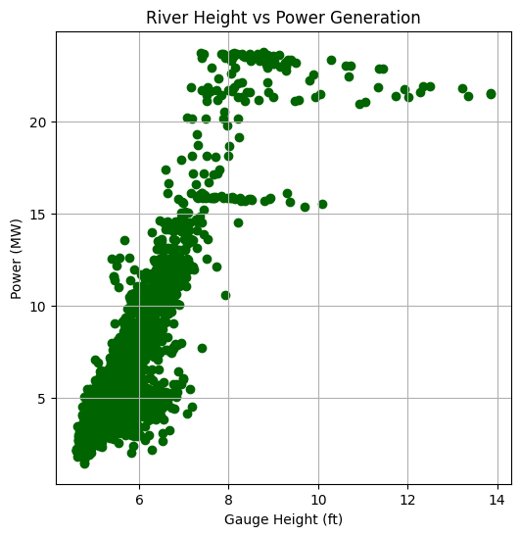
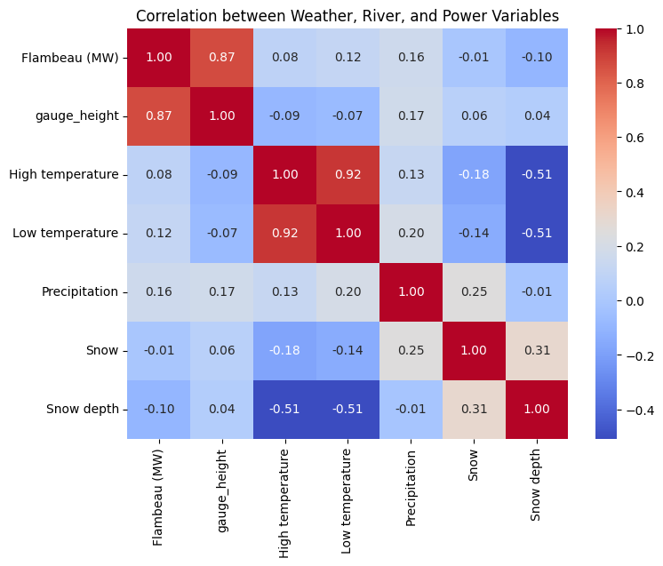
Exploratory Data Analysis Part 2: Relationships
River height has strong correlation with power output
  More water = more energy (up to a point)
Generation slows down when river at ~7 ft, plateaus at ~8 ft
  18.96 MW Rated Capacity

Slide 4
Modeling Approach
Clean Raw Data
Train Machine Learning Model
Linear Regression + Random Forest Models
Evaluate Performance Metrics
Predict Energy Generation for 10/24-30

Slide 5
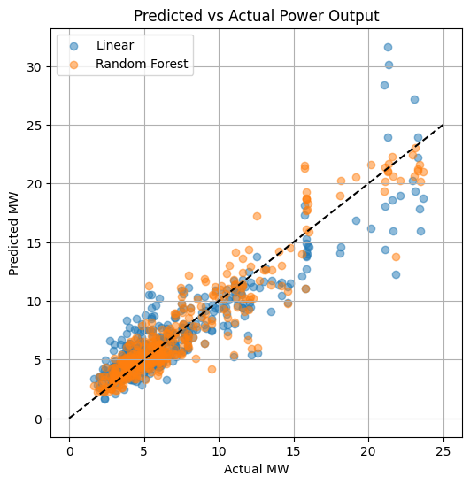

Model Performance
Linear Regression
  MAE: 1.5 MW
  $R^{2}$: 81%
Random Forest
  MAE: 1.15 MW
  $R^{2}$: 89%; The other 11%:
    Dam operations
    Additional river conditions
    Lag effect, etc.
Notes:
Put these on notecards. Shorten. Make bigger
Not “we”
I was curious, so …
Doesn’t prove anything, but suggests …

Slide 6
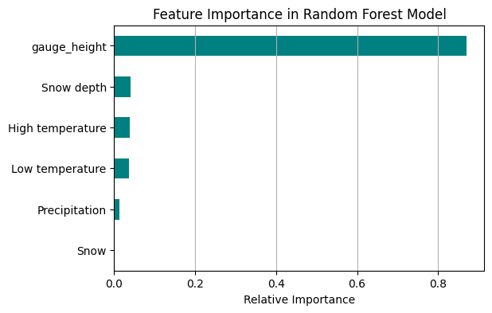
Additional Research
Model decided gauge height to be most determinate variable (87%)
Other variables add minor refinements

Slide 7
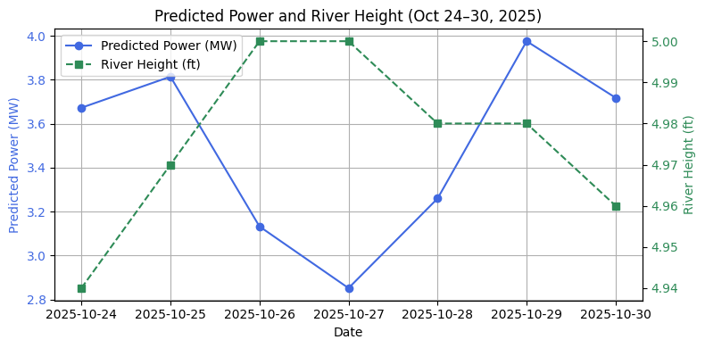
Predictions for Oct 24-30, 2025
Ranges from 2.85-3.96 MW
River height forecast remains nearly constant (4.9-5.0 ft)
When gauge height = 4.9-5.1 ft, average generation ≈ 3.8 MW (+/- 0.9 MW)
Notes:
Clean up points

Slide 8
Final Thoughts
&
Reflection

